Slide 1


Deep Guided
Transformer Network for Dehazing
DS3411 Project Work II
Second Review
KEYWORDS: Image Restoration, Swim Transformer, dehaze, Feature Learning, Guided Filter
Guided By,
Dr. G Geetha
Associate Professor
Department of IST
Anna University
Presented By,
Mohammed Abdullah
(2023176026)
M.Tech(IT)(AI&DS)
Dept. of IST, CEG

Slide 2
Literature Survey
TITLE | JOURNAL/CONFERENCE DETAILS AND YEAR OF PUBLICATION | HIGHLIGHTS OF APPROACH(S) FOLLWED | CHALLENGES TO BE ADDRESSED
Deep guided transformer dehazing network. | Zhang S, Zhao L, Hu K, Feng S, Fan E, Zhao L. Deep guided transformer dehazing network. Sci Rep. 2023 Sep 15;13(1):15333. doi: 10.1038/s41598-023-41561-z. | Swim Transformer network in parallel with Radial Dilation Network. Upsampling via Guided Filtering | Computationally expensive transformers

Slide 3
Literature Survey
TITLE | JOURNAL/CONFERENCE DETAILS AND YEAR OF PUBLICATION | HIGHLIGHTS OF APPROACH(S) FOLLWED | CHALLENGES TO BE ADDRESSED
GTMNet: a vision transformer with guided transmission map for single remote sensing image dehazing | Li, H., Zhang, Y., Liu, J. et al. GTMNet: a vision transformer with guided transmission map for single remote sensing image dehazing. Sci Rep 13, 9222 (2023). https://doi.org/10.1038/s41598-023-36149-6 | Used Swim Transformer in parallel with convolution layers | Lack Semantic priors

Slide 4
Literature Survey
TITLE | JOURNAL/CONFERENCE DETAILS AND YEAR OF PUBLICATION | HIGHLIGHTS OF APPROACH(S) FOLLWED | CHALLENGES TO BE ADDRESSED
Revitalizing Convolutional Network for Image Restoration | Y. Cui, W. Ren, X. Cao and A. Knoll, "Revitalizing Convolutional Network for Image Restoration," in IEEE Transactions on Pattern Analysis and Machine Intelligence, vol. 46, no. 12, pp. 9423-9438, Dec. 2024, doi: 10.1109/TPAMI.2024.3419007 | Tanh function instead of softmax Bypassing the limitation of low-pass filters with the hyperbolic tangent function (Tanh), and Elevating the significance of high-pass filters in attention weights via the proposed filter modulation (FM). Different Degraded Image Sized Input | Lack attention mechanisms
Notes:
projects attention weights into (-1, 1), the negative weights can help suppress the detrimental pixels when performing information aggregation.

Slide 5
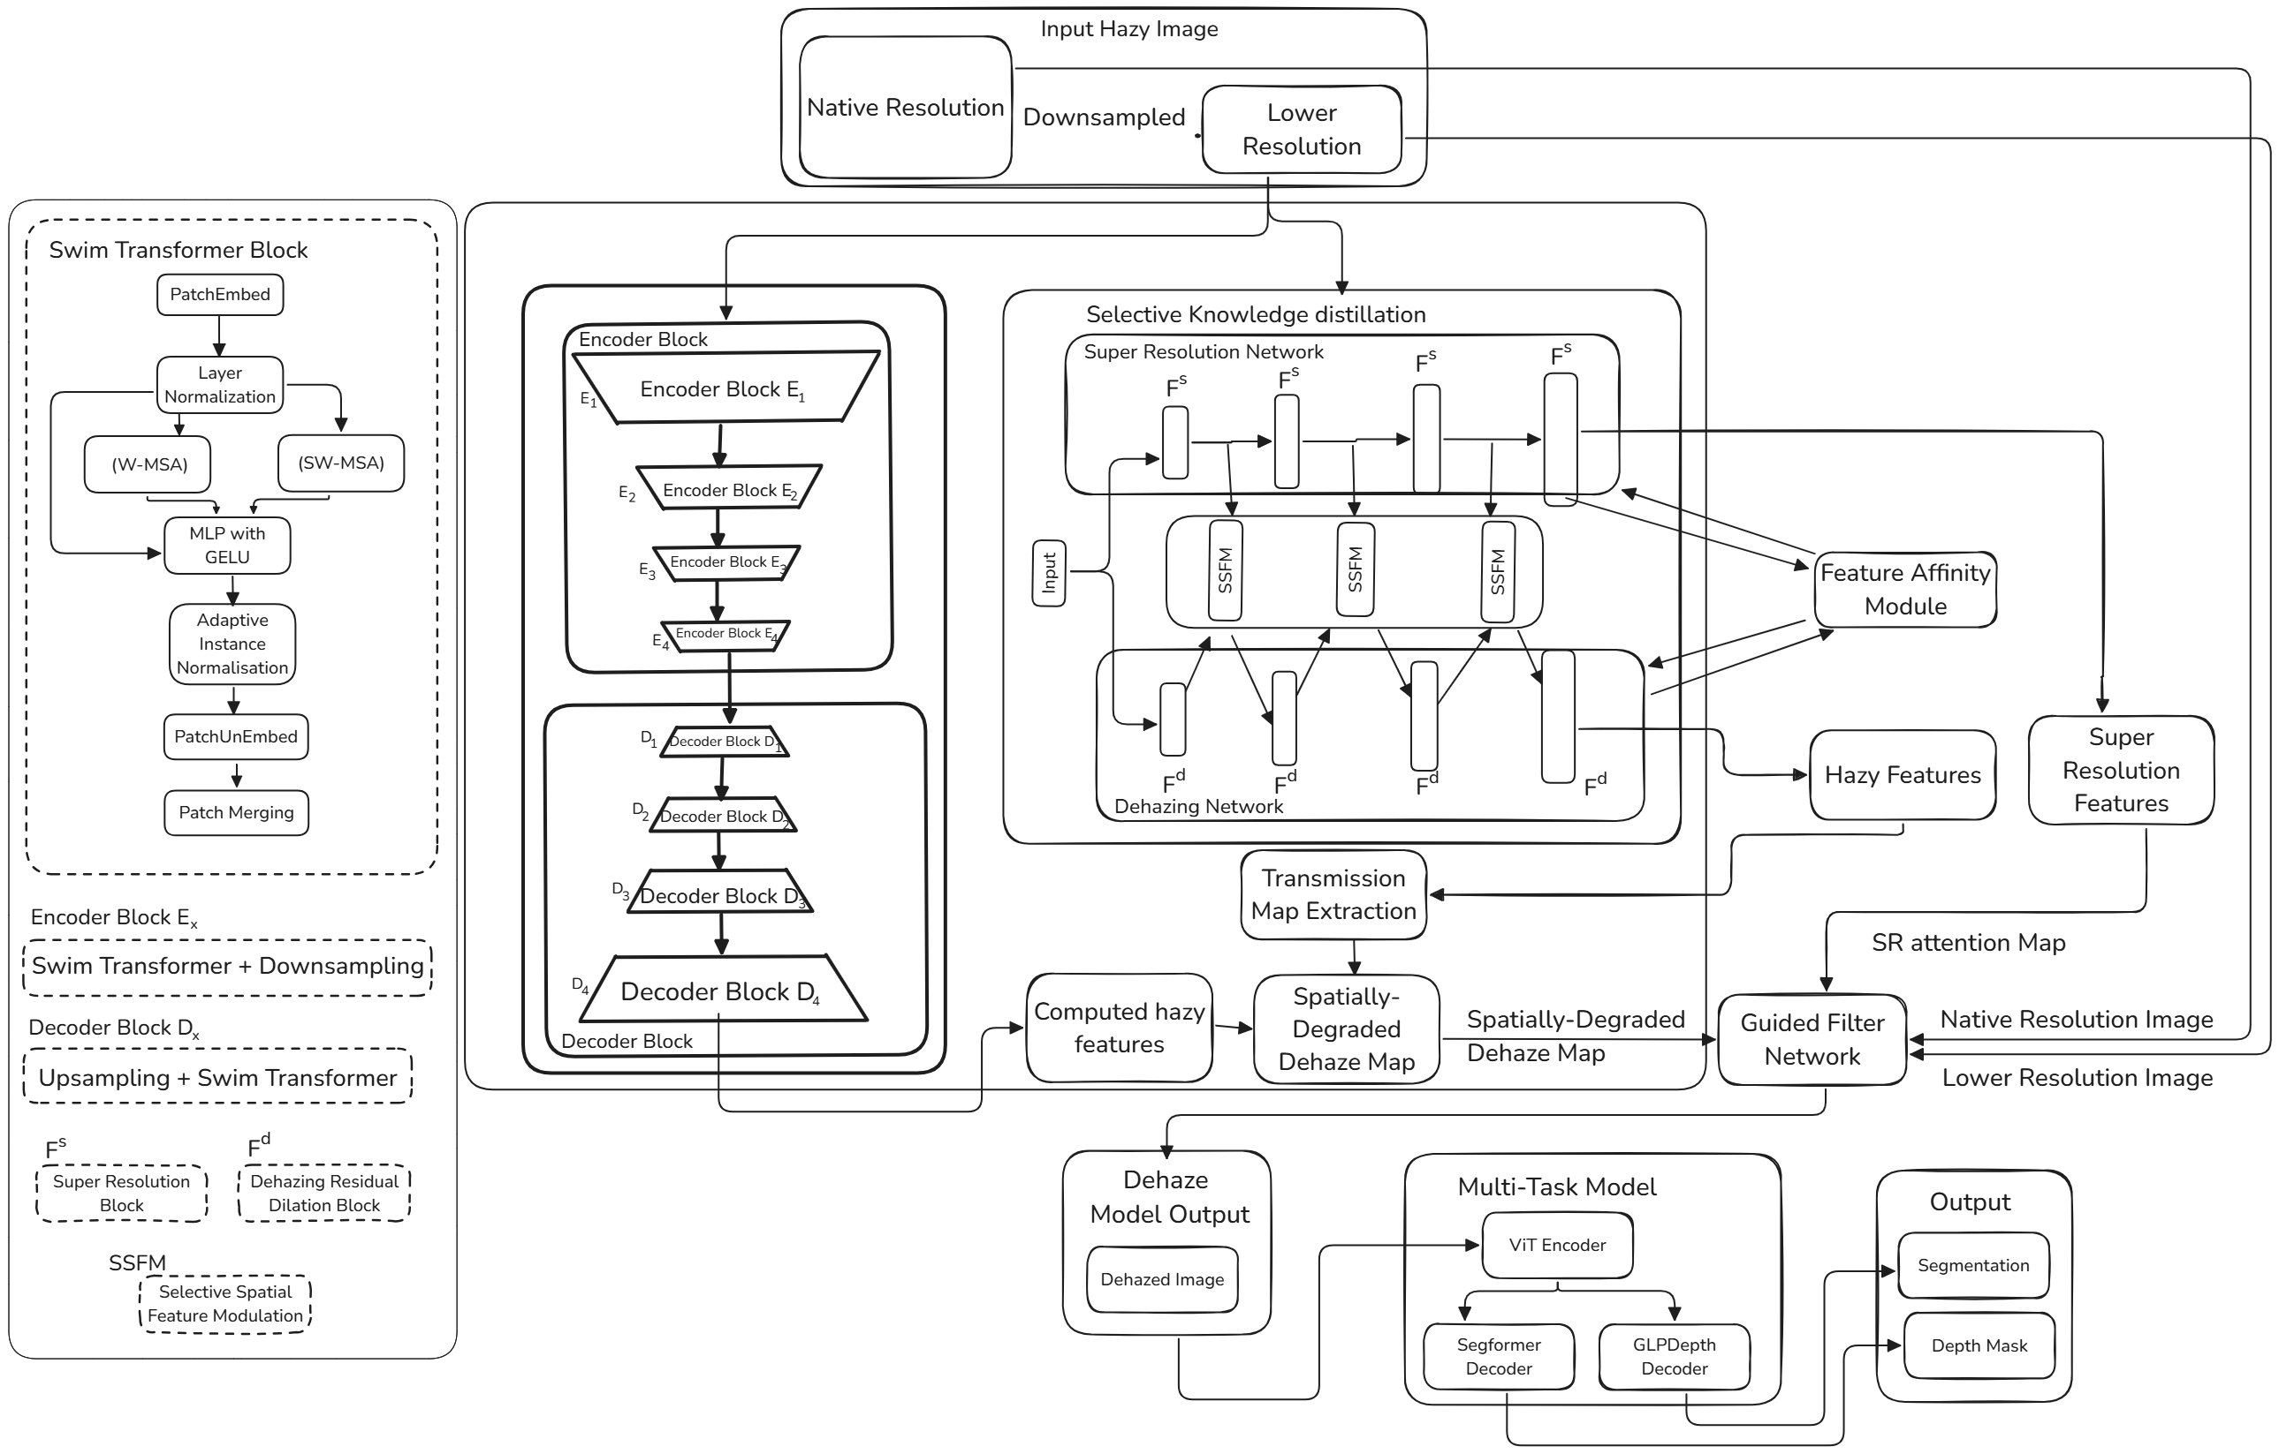
Architecture

Slide 6
Contributions
MSA and S-MSA is done with horizontal reflexive shifts instead of Cyclic Shift of Patches. Adaptive instance normalisation is done only on ground followed by layer normalisation.
Selective Knowledge Distillation from Heterogeneous Task (SR).
Dilated Convolutions at various levels have their features shared by reweighting the input channel wise during distillation.
DCP is applied to all feature channels, and the highest features in the channels are selected. This is done by a learnable thresholding parameter for dense haze and less haze.

Slide 7
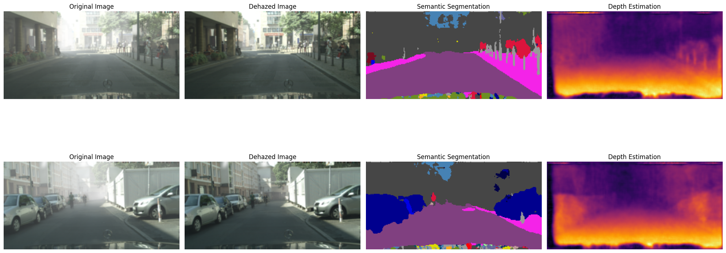
Segmentation and Monocular Depth Estimation

Slide 8
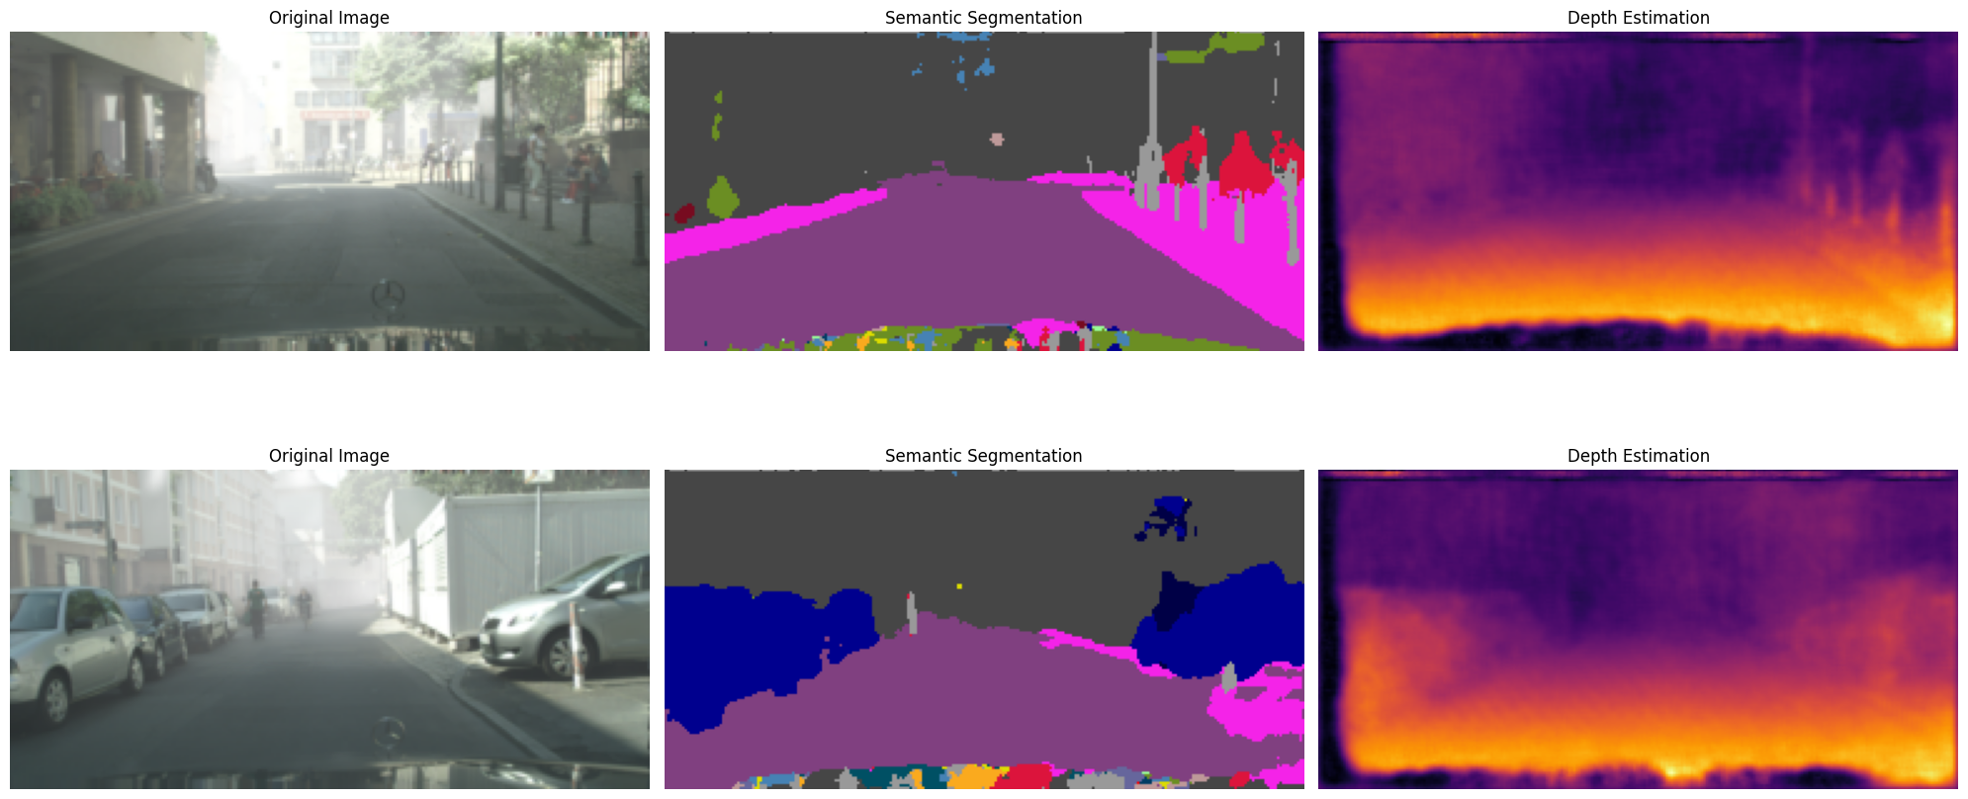
Segmentation and Monocular Depth Estimation

Slide 9
BaseNet: Swim Transformer Network

Slide 10
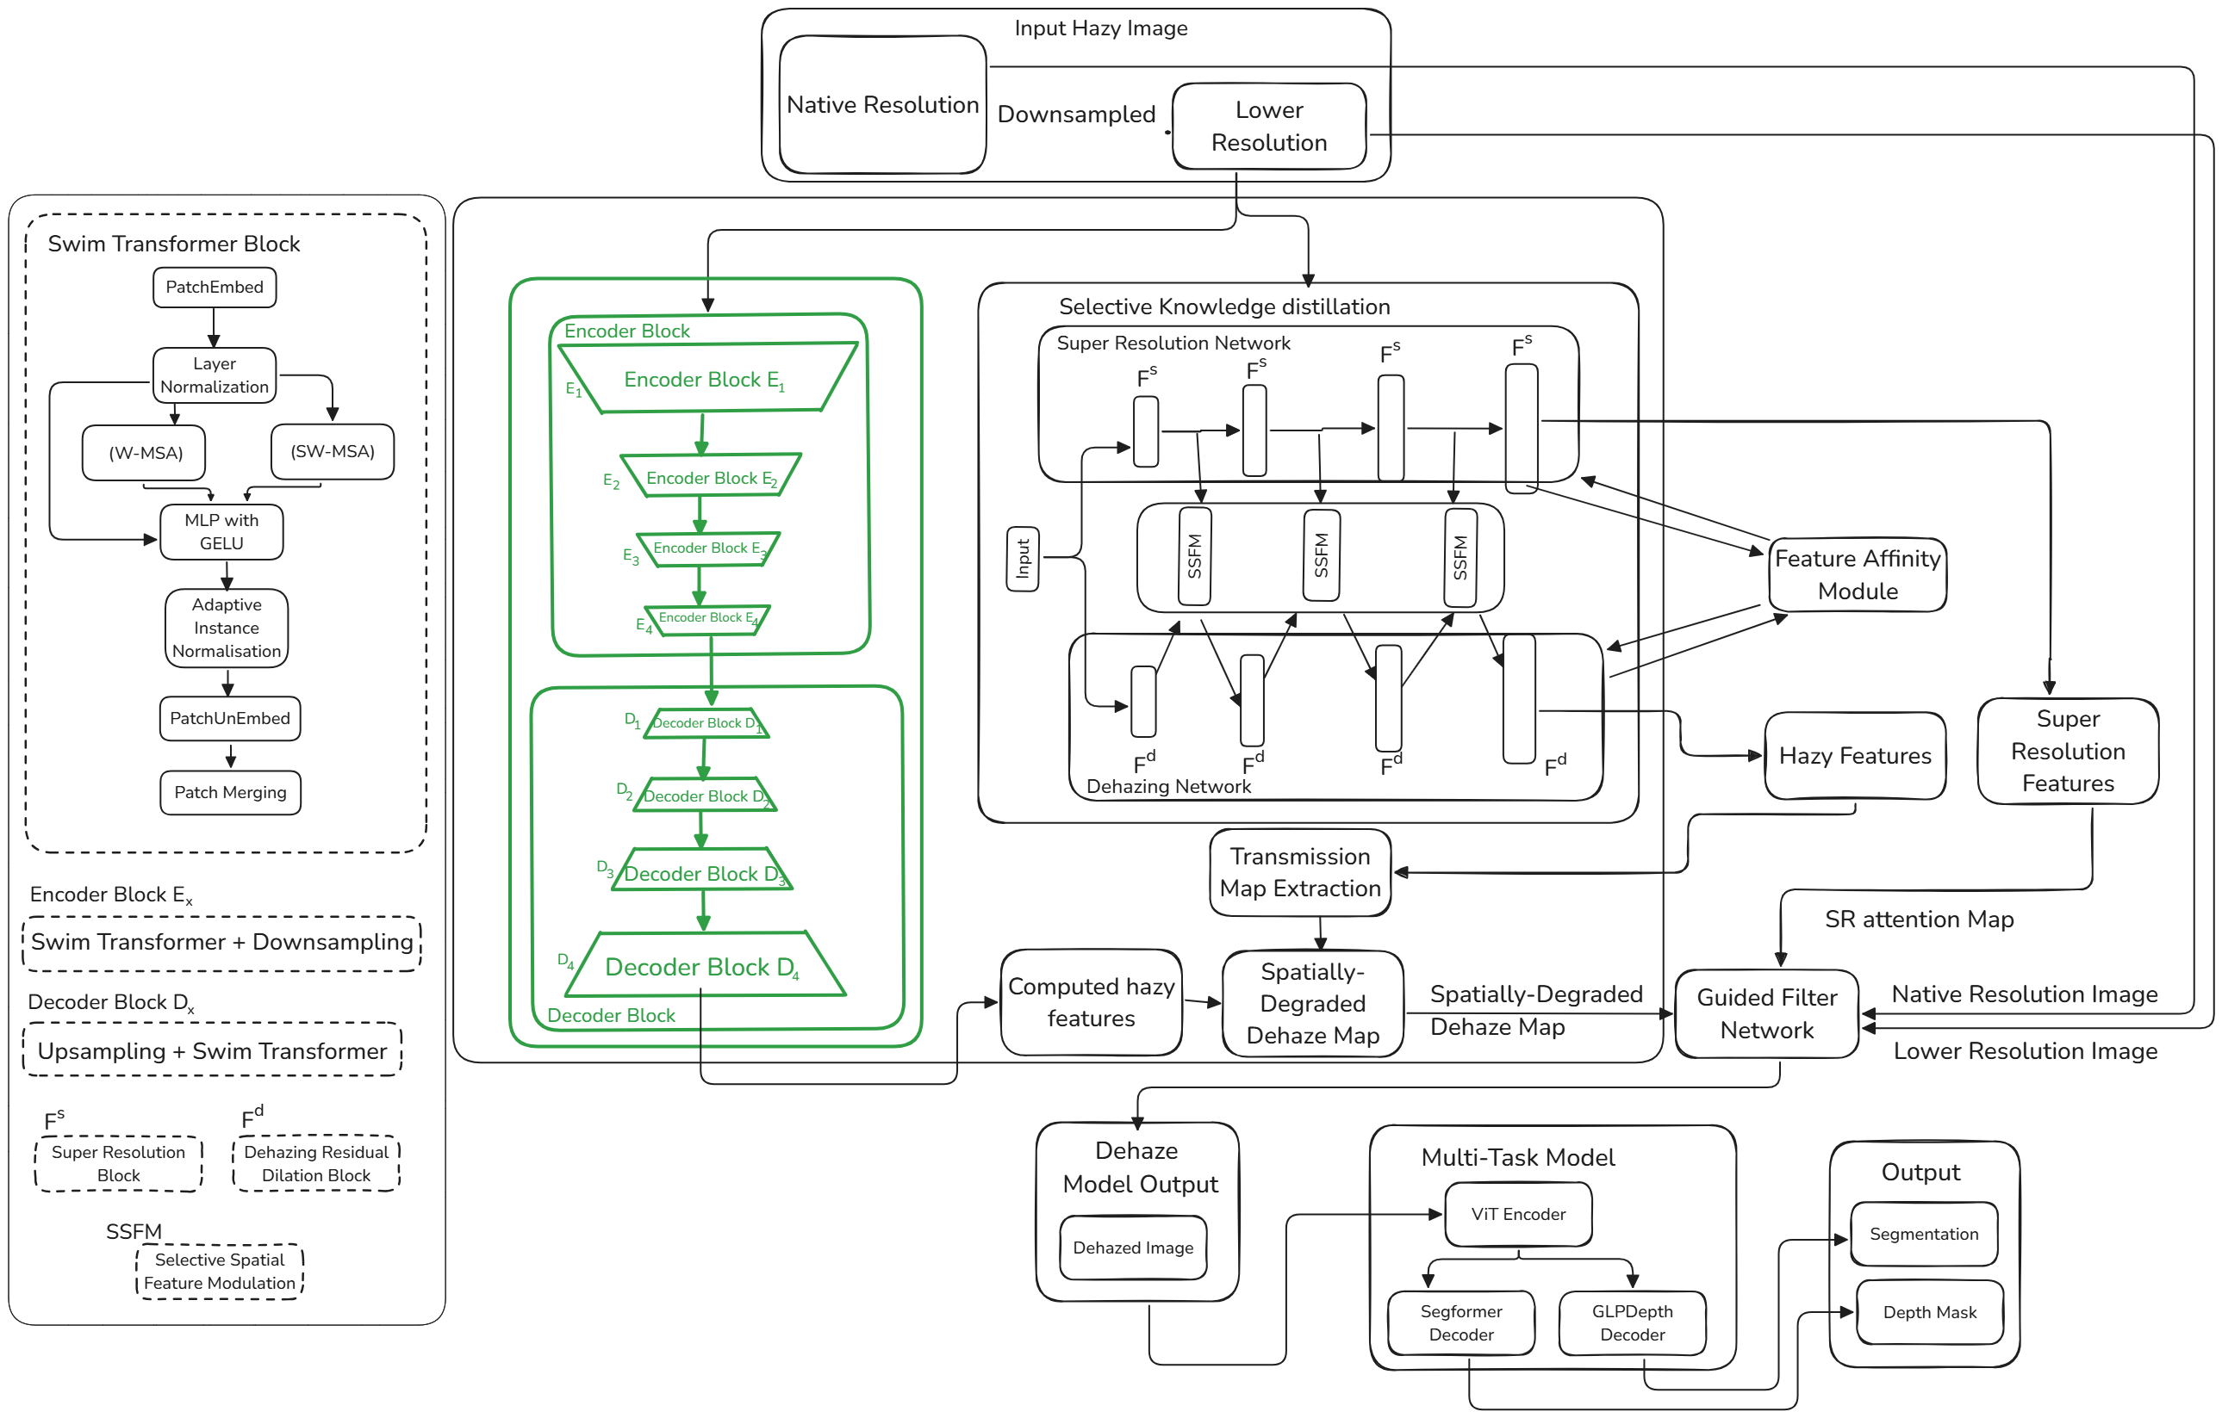
Swim Transformer
Network

Slide 11
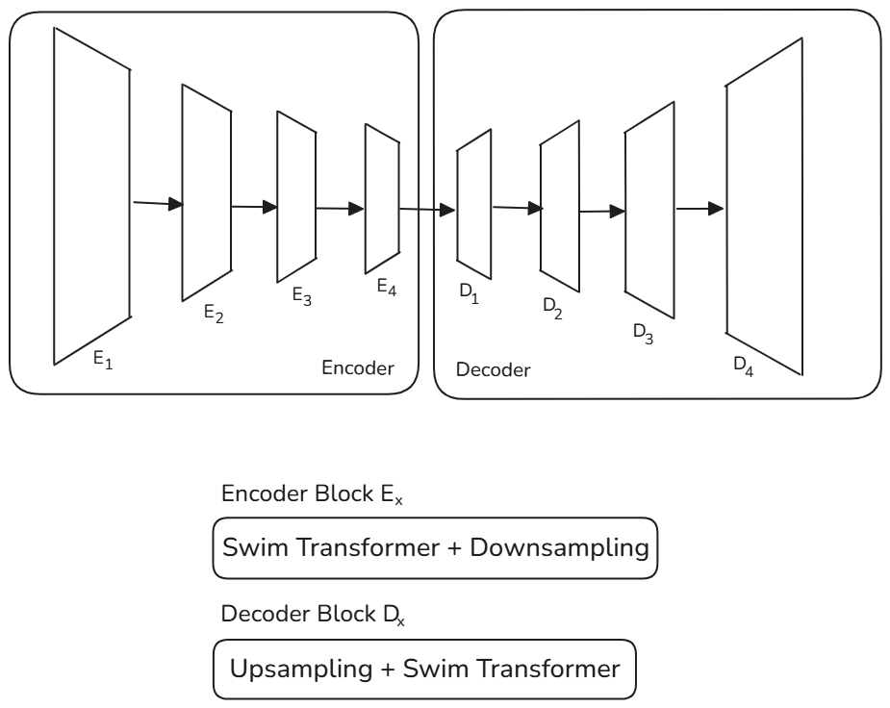
BaseNet

Slide 12
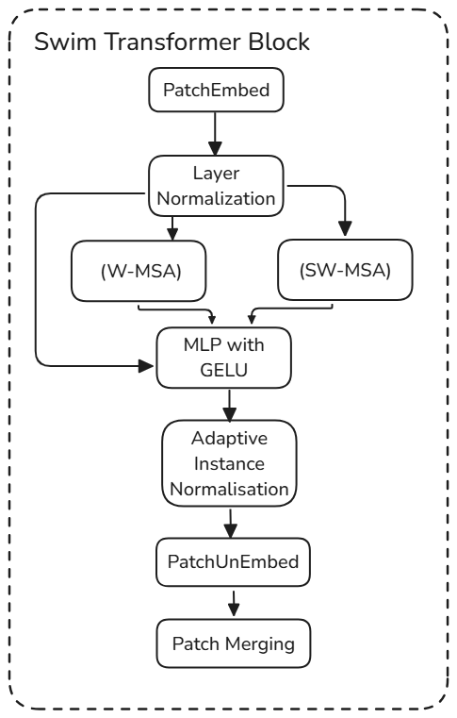
BaseNet

Slide 13
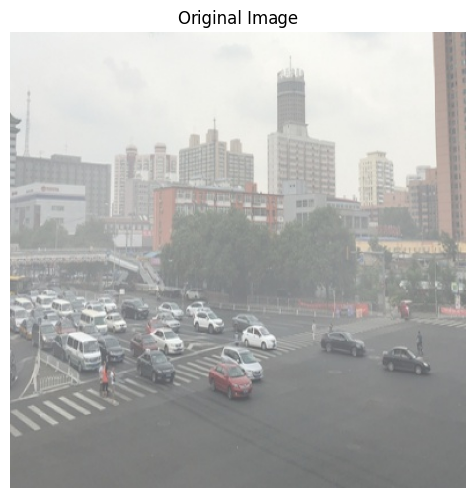
Swim Transformer: Patch Embed
MSA and S-MSA is done with Cyclic Shift of Patches
The patches are divided and encoded with initial values without the concatenation of positional information.

Slide 14
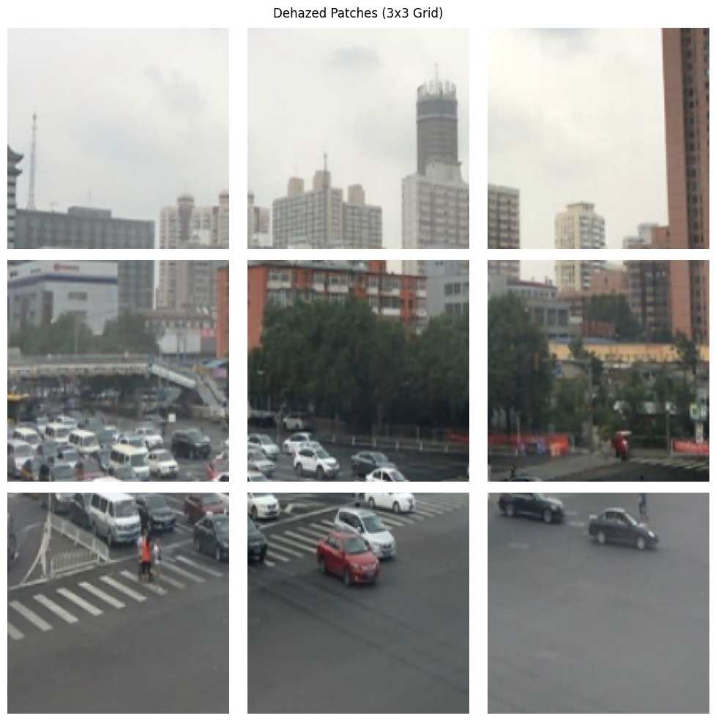

Slide 15
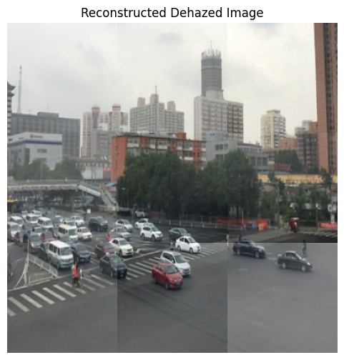
Swim Transformer: Patch Merging
Dehazing Sky has a different result from dehazing land.

Slide 16
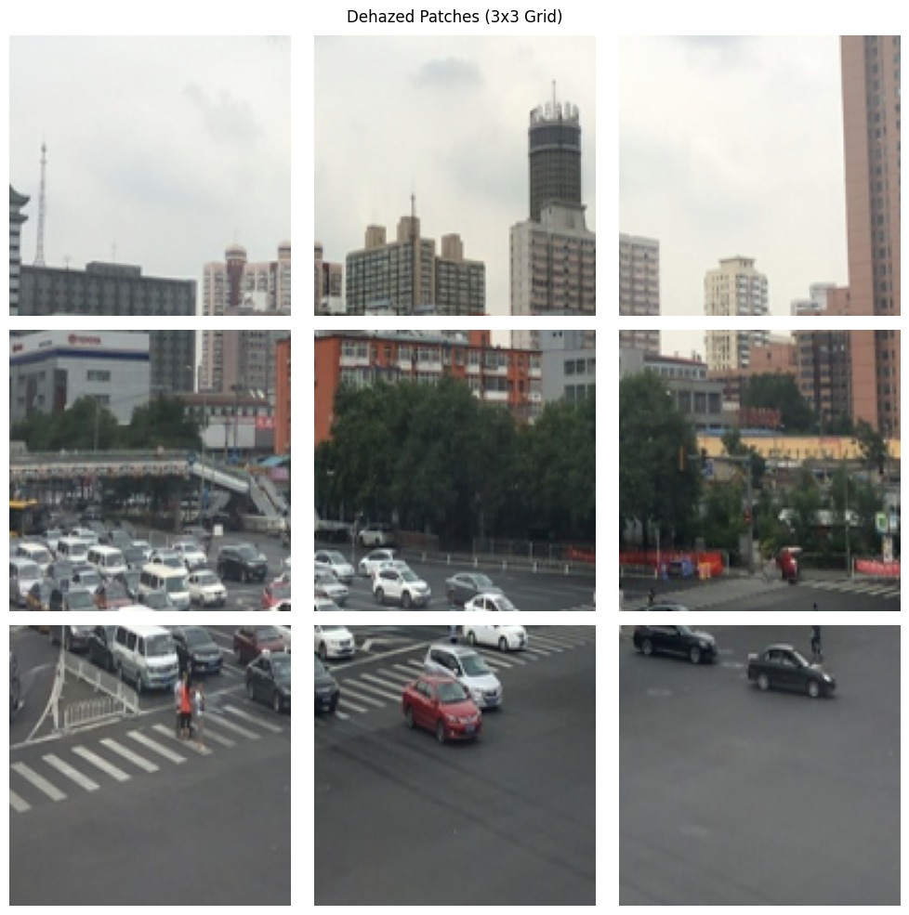
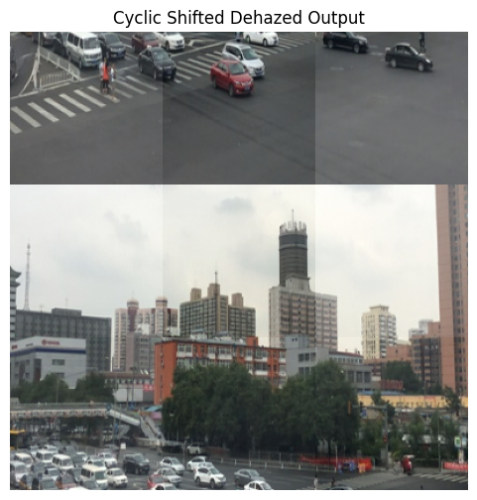
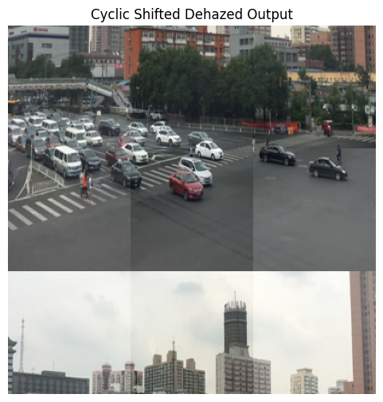

Slide 17
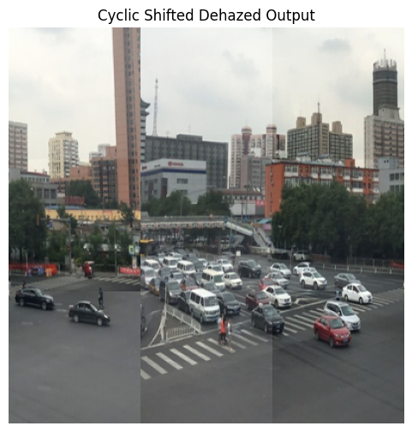
Cyclic shift on horizontal direction gave error in S-MSA Backpropagation

Slide 18

Adaptive normalisation
Instance normalization is performed across patches to give the image a flow of dehazing.

Slide 19
DetailNet: Dilated Convolutional Network

Slide 20
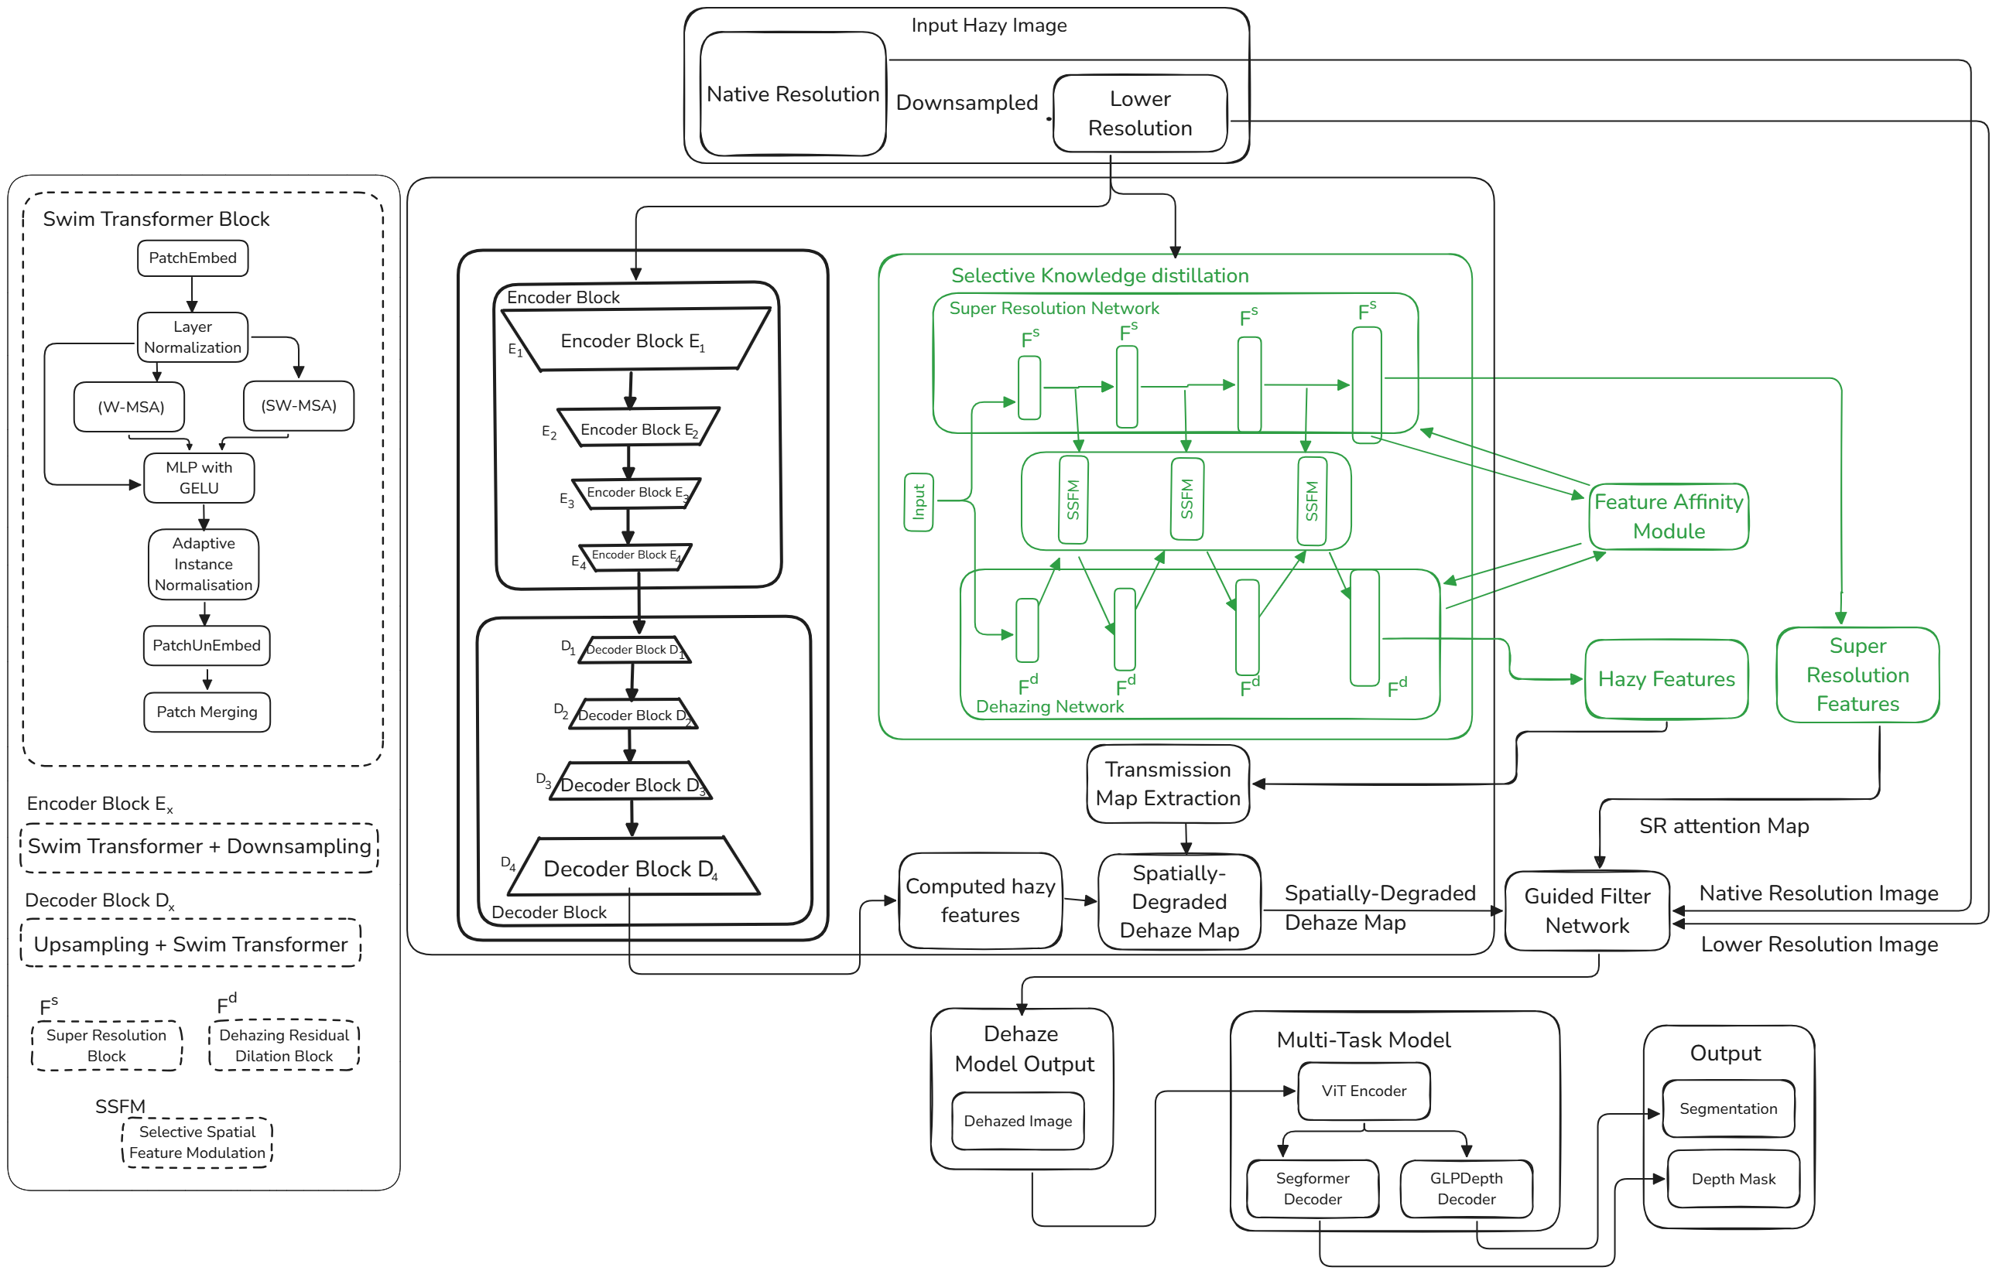
Dilated Convolutional
Network

Slide 21
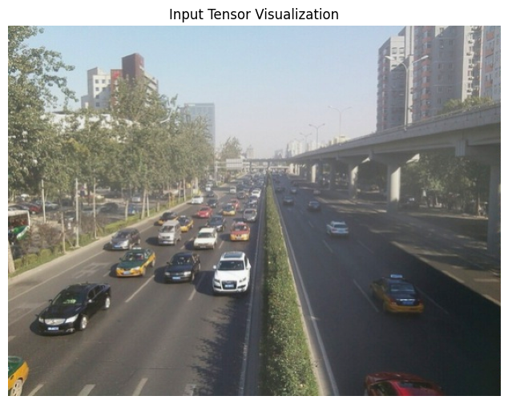
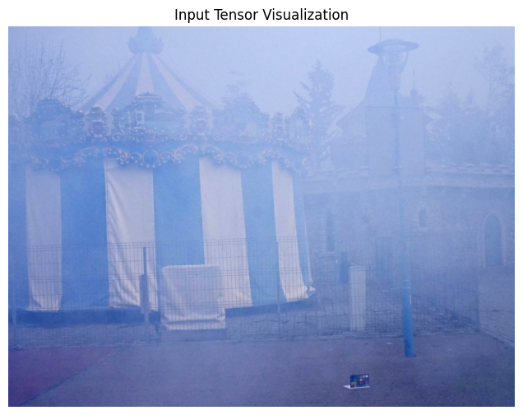
Densely Hazed Image Vs Foggy Image

Slide 22
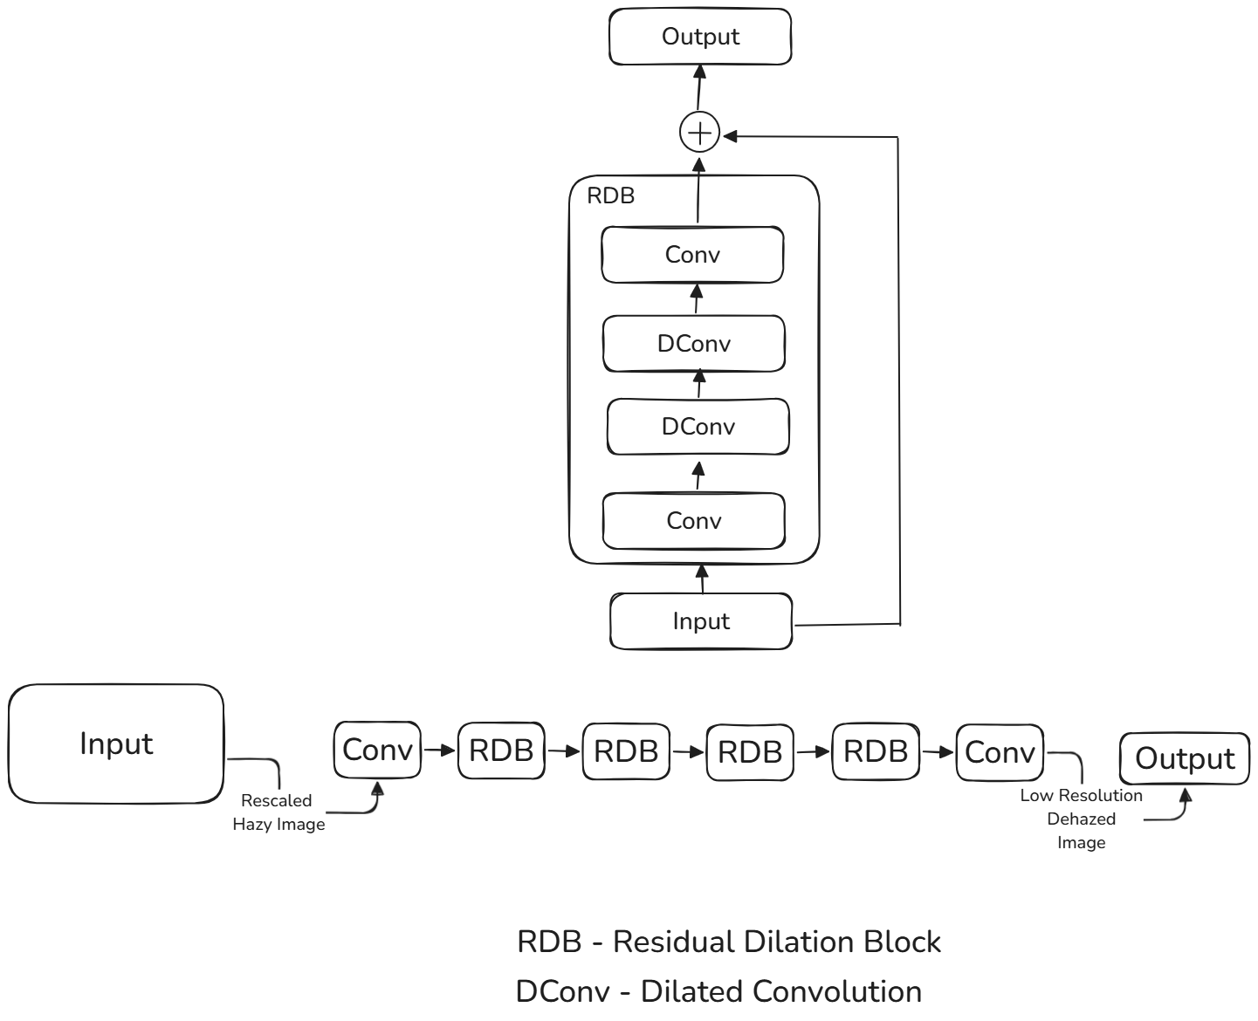
DetailNet

Slide 23
RDB with Cross-Task Feature Transfer
Heterogeneous Knowledge Distillation
Tasks:
Super Resolution Network
Dehazing Network
Both behave as Student and Teacher Module each time.

Slide 24
Dilation Process
Dense Haze Image : Less Features
Foggy Image : Comparatively More Features

Slide 25
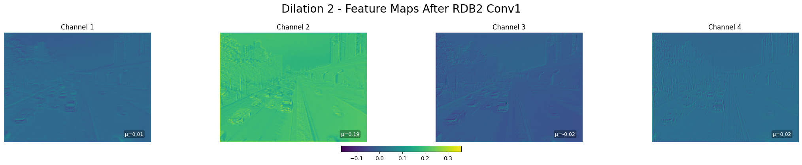
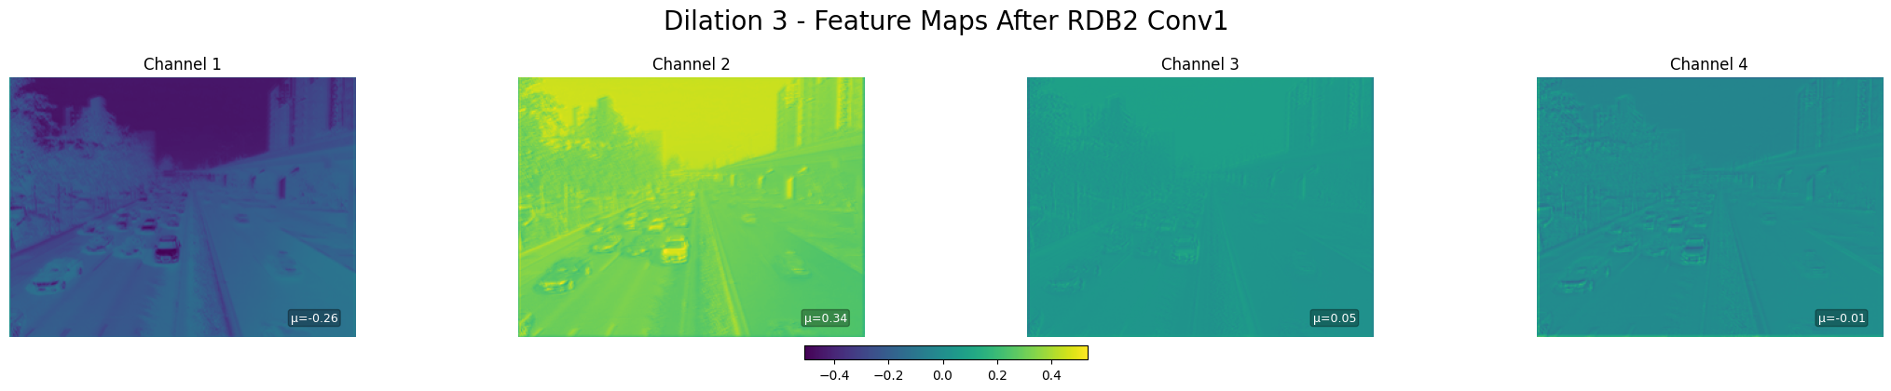
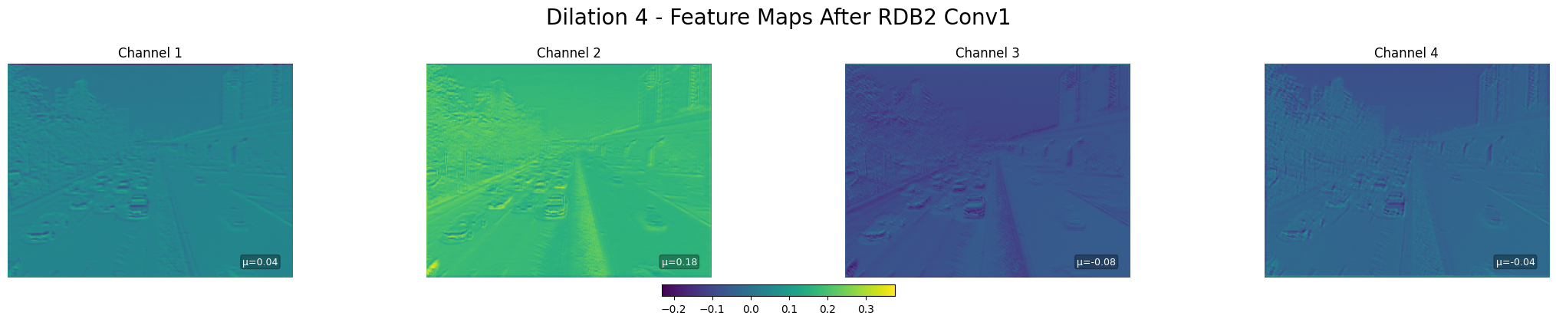
Dilation Process: Dense Haze

Slide 26
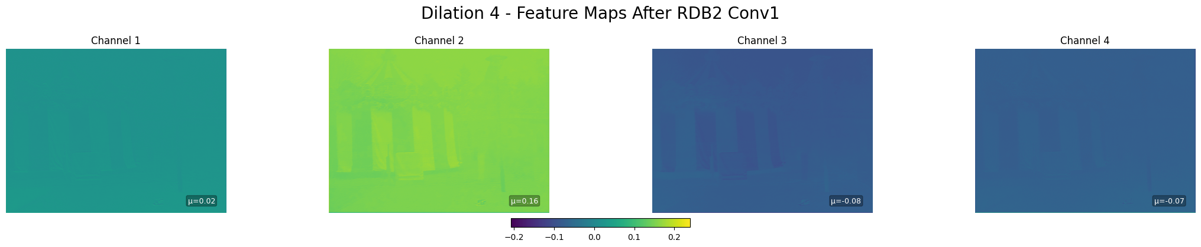
Dilation Process: Dense Haze

Slide 27
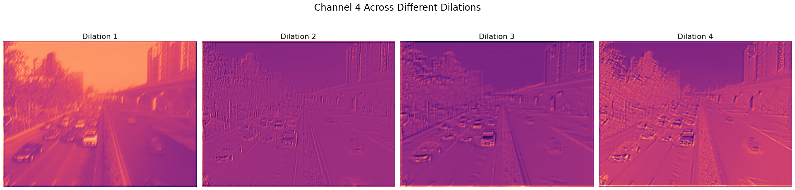
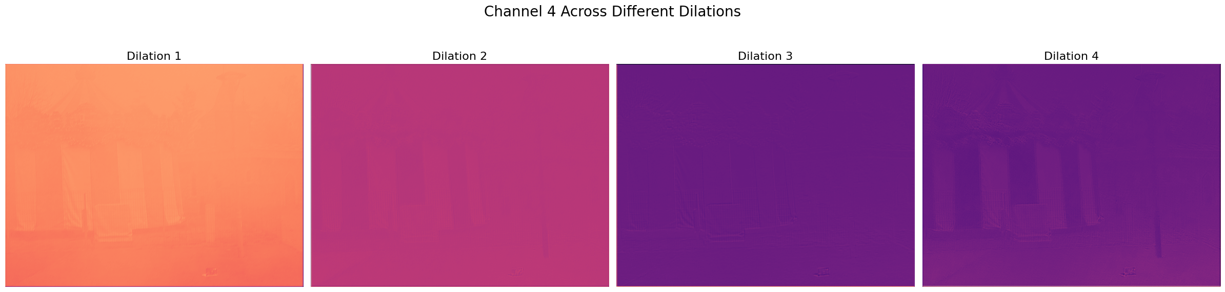
Dilation: Foggy Image

Slide 28
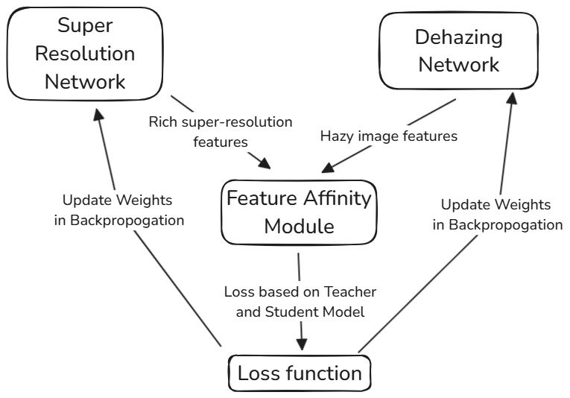
RDB with Cross-Task Feature Transfer

Slide 29
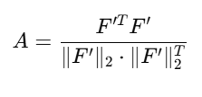
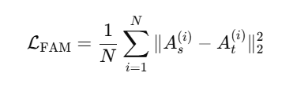
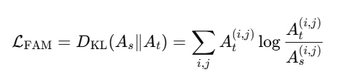
Feature Affinity Module
Input: Features Maps and of teacher and student respectively
Output: Loss
Compute Feature Affinity Matrix
Compute Loss Function
Retune KL Divergence
Perform this by exchanging student and teacher model in step 1
Concatenate the result in step 4 and use in the main loss function

Slide 30
RDB with Cross-Task Feature Transfer: Feature Affinity Module
Bridging Two Heterogeneous Tasks
The teacher network is trained for super-resolution (SR), which enhances fine details in images.
The student network is trained for dehazing, which aims to remove haze and recover clear details.
Since SR naturally improves high-frequency details, its feature representations contain rich semantics that can guide the dehazing model.

Slide 31
RDB with Cross-Task Feature Transfer: Feature Affinity Module(FAM)
Aligning Feature Distributions
FAM extracts intermediate feature maps from both networks and computes their spatial and channel-level distributions.
It uses Kullback–Leibler (KL) divergence and L2 loss to minimize the difference between the teacher’s (super-resolved) and student’s (dehazed) feature maps.
This ensures that the student learns to generate clearer images with better textures by following the teacher’s feature representation.

Slide 32
Physics Based Learning with Features

Slide 33
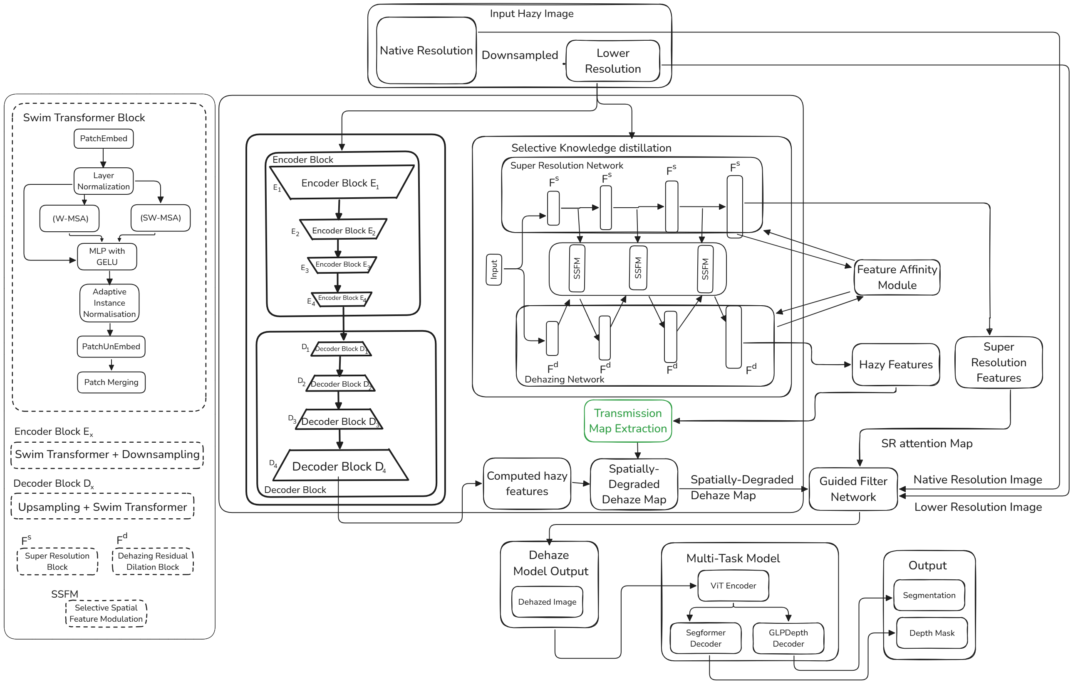
Transmission Map Extraction

Slide 34
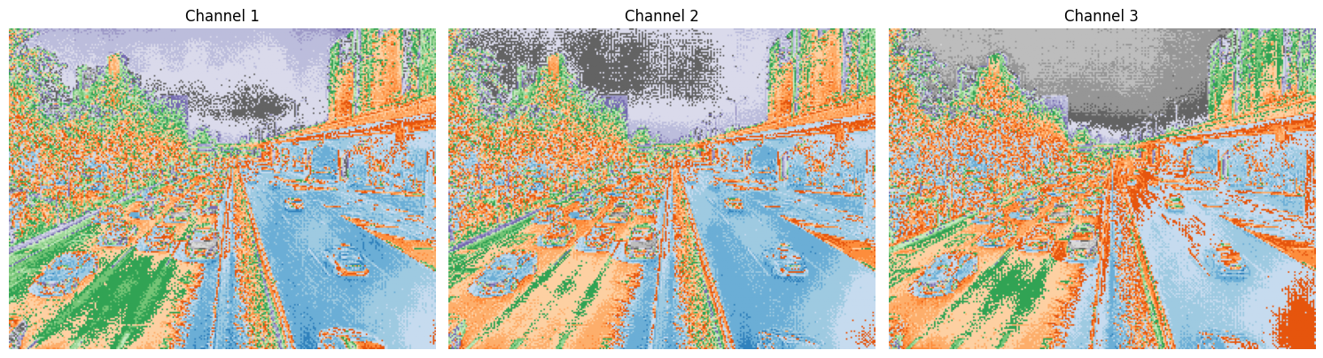
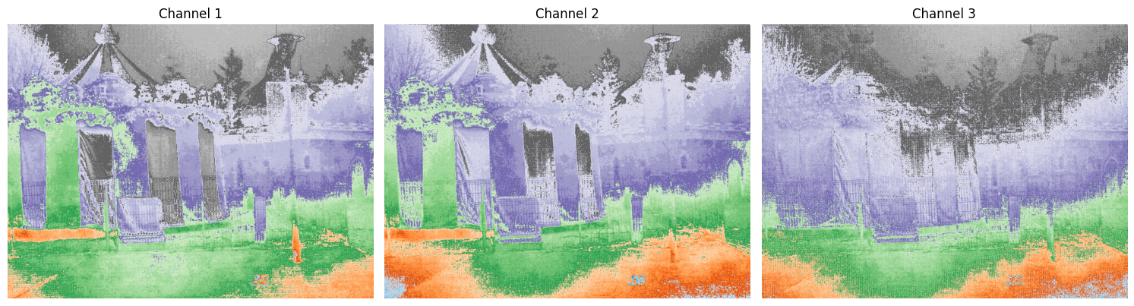
Transmission Map

Slide 35
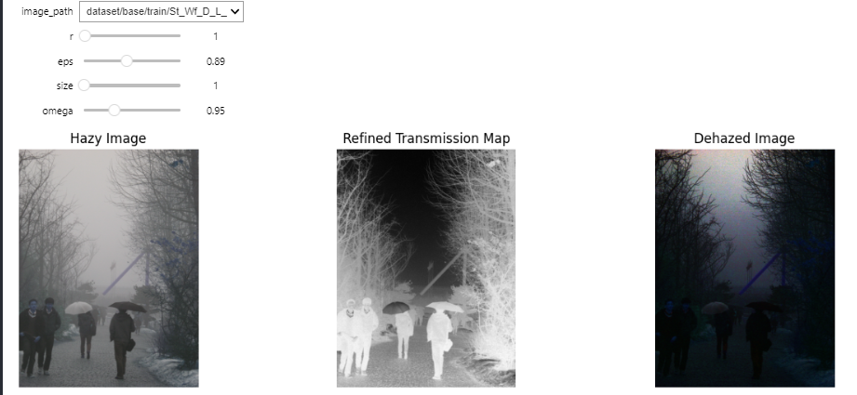
Physics Based Learning: Tuning Parameters
Notes:
U is a bilinearly upsample operation
Box represents the box fltering

Slide 36
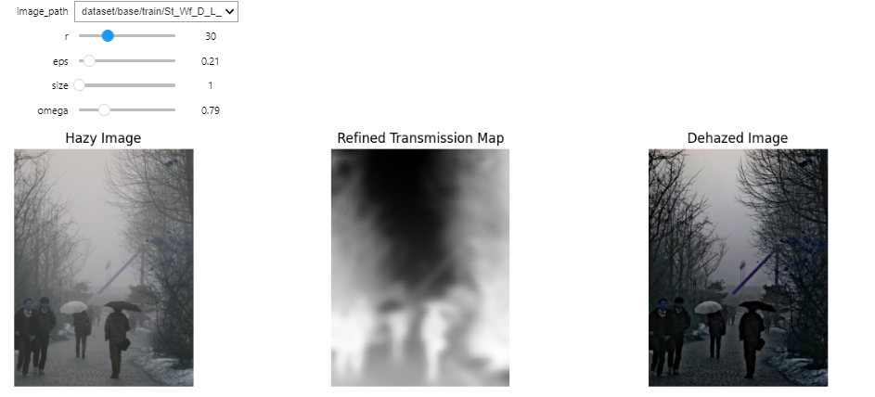
Tuning Parameters
Notes:
U is a bilinearly upsample operation
Box represents the box fltering

Slide 37
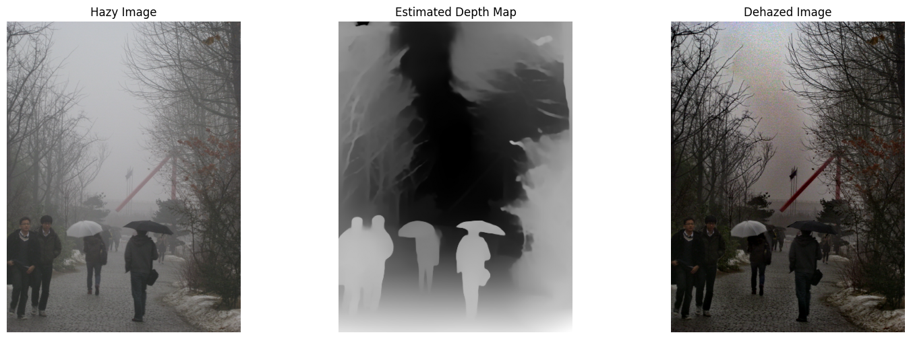
Transmission Map Based Dehazing

Slide 38
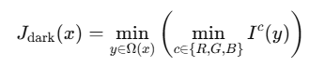
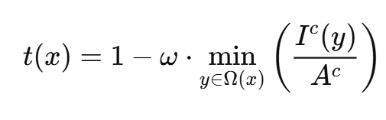
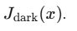
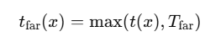
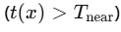
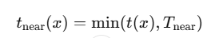
Transmission Map Extraction From Selective Feature Channels
Input: Feature Channel Image , with pixels x
Output: Transmission Map Prior
Compute Dark Channel Prior (DCP) for each pixel x,
Where Ω(x) is the local patch around pixel x
Estimate Atmospheric Light 𝐴 by selecting top 0.1% brightest pixels in
Compute Transmission Map using transmission model
Adjust Transmission Based on Depth:
a. Far-depth regions
b. Near-depth regions

Slide 39
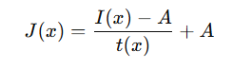
Transmission Map Extraction From Selective Feature Channels
Recover the Prior Image
Feed the prior image into dehazing head by concatenating the input channels from swim transformer network.

Slide 40
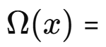
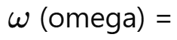
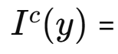
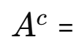
Transmission Model
Local patch around pixel 𝑥 (e.g., 15×15 window).
Local window (patch) around pixel 𝑖
Intensity of pixel 𝑦 in color channel 𝑐.
Estimated atmospheric light in color channel 𝑐.

Slide 41
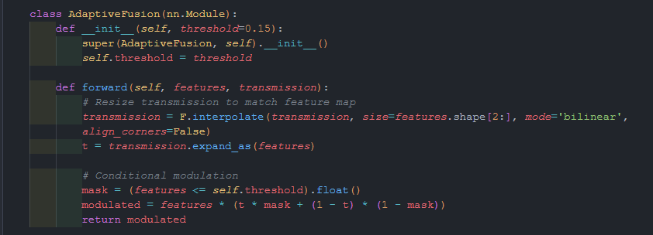
Transmission Map Extraction From Selective Feature Channels

Slide 42
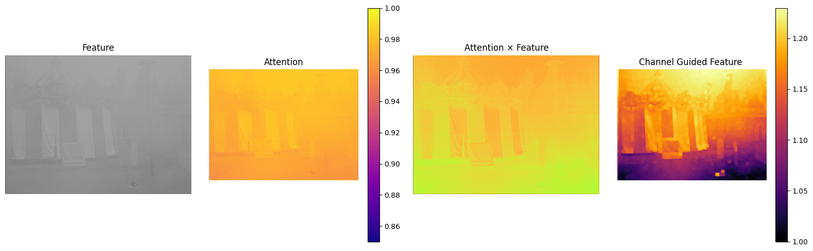
Feature Extraction with Selective Channels

Slide 43
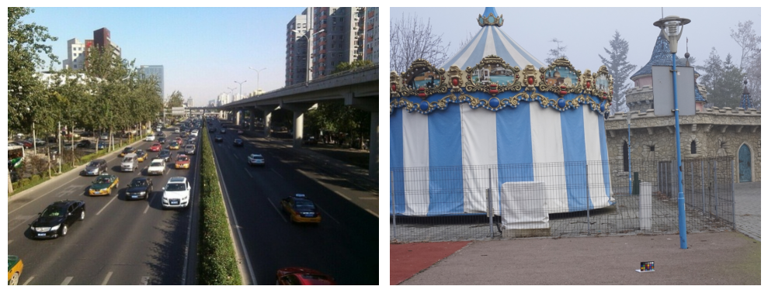
Densely Hazed Image Vs Foggy Image: Output

Slide 44
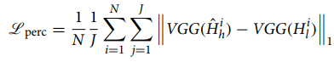
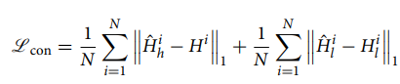
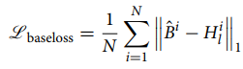

Loss Function

Slide 45
Perceptual Loss: Loss Function
VGG16, pre-trained on a large dataset (ImageNet), which can extract meaningful features from images is used.
Pixel-wise losses can sometimes lead to overly smooth or unrealistic results because they focus solely on minimizing pixel differences.
Perceptual loss, on the other hand, encourages the model to generate images that are semantically and structurally consistent with the target

Slide 46

Taking only Activation Function Layers

Slide 47


Taking only Activation Function Layers

Slide 48

Taking only Activation Function Layers

Slide 49

Hierarchical Features – Lower layer

Slide 50

Hierarchical Features – Middle layer

Slide 51

Hierarchical Features –Higher layer

Slide 52

GuidedFilterNet
Notes:
Image degradation due to light scattering
U is a bilinearly upsample operation
Box represents the box fltering

Slide 53

GuidedFilterNet
Dehaze Output
Guided Filter Output

Slide 54


GuidedFilterNet: Feature Reconstruction
Dehaze Output
Guided Filter Output

Slide 55


Image With Loss Coefficients
Notes:
Local Linear Model

Slide 56




Parameters to be learned with Haze Remove Network
Initial estimated transmission map
Local window (patch) around pixel 𝑖
Regularization parameter to prevent
overfitting and noise amplification
Notes:
To compute a and b, we minimize the cost function:

Slide 57




Approximation of Atmospheric Transmission Model
J is the latent haze-free image,
A is the global atmospheric light,
t is the medium transmission map
F(MLP)=Linear-ReLU-Linear
Notes:
Koschmieder
Polynomial with 2 variables

Slide 58

GuidedFilterNet
Notes:
U is a bilinearly upsample operation
Box represents the box fltering

Slide 59

Metrics
Peak signal-to-noise ratio (PSNR) is a metric used to measure the quality of an image or video.

Slide 60

Metrics
Structural Similarity Index (SSIM): a metric used to measure the quality of an image or the similarity between two images

Slide 61
Metrics: Reside Dataset
SSIM | PSNR
0.9297 | 29.60

Slide 62
References
[1] Zhang S, Zhao L, Hu K, Feng S, Fan E, Zhao L. Deep guided transformer dehazing network. Sci Rep. 2023 Sep 15;13(1):15333. doi: 10.1038/s41598-023-41561-z.
[2] Y. Cui, W. Ren, X. Cao and A. Knoll, "Revitalizing Convolutional Network for Image Restoration," in IEEE Transactions on Pattern Analysis and Machine Intelligence, vol. 46, no. 12, pp. 9423-9438, Dec. 2024, doi: 10.1109/TPAMI.2024.3419007
[3] J. Dai et al., "Deformable Convolutional Networks," 2017 IEEE International Conference on Computer Vision (ICCV), Venice, Italy, 2017, pp. 764-773, doi: 10.1109/ICCV.2017.89.

Slide 63
References
[4] Z. Z. Gu, D. Yin, S. P. Nie, S. T. Feng and C. J. Yuan, "Butterworth spiral filter for image processing with edge enhancement," 2019 Cross Strait Quad-Regional Radio Science and Wireless Technology Conference (CSQRWC), Taiyuan, China, 2019, pp. 1-3, doi: 10.1109/CSQRWC.2019.8799210.
[5] N. Sonti, R. M. S. S and V. R. Pamulapati, "Image Filtration using Graph-based Low Pass Filter," 2022 International Conference on Recent Trends in Microelectronics, Automation, Computing and Communications Systems (ICMACC), Hyderabad, India, 2022, pp. 125-130, doi: 10.1109/ICMACC54824.2022.10093299.
[6] M. B. Shahid, Um-e-Rubab, M. A. Abbasi and M. Muazzam, "Detection of noise in high pass IIR digital filters," 2015 International Conference on Humanoid, Nanotechnology, Information Technology,Communication and Control, Environment and Management (HNICEM), Cebu, Philippines, 2015, pp. 1-5, doi: 10.1109/HNICEM.2015.7393222.

Slide 64
Thank You

Slide 65
Annexure

Slide 66
OVERVIEW
Problem Statement
Literature Survey
Architecture

Slide 67
PROBLEM STATEMENT
Completed
Simultaneous Semantic Segmentation and Monocular Depth Estimation: The challenge is to design a Vision Transformer model that can effectively handle both
semantic segmentation and monocular depth estimation from a single input image.
Existing methods often require separate models for each task, leading to increased
computational cost and complexity.
The problem lies in finding a unified approach that maintains accuracy for both tasks
while optimizing for speed and efficiency.

Slide 68
PROBLEM STATEMENT
Phase 2:
Improved Segmentation and Depth Estimation in Low-Visibility Conditions:
In low-visibility environments such as fog or rain, traditional vision models struggle to accurately segment objects and estimate depth due to the blurry and noisy nature of the input images.
The problem is to enhance the performance of a system to improve both segmentation and depth estimation in such adverse conditions, where current techniques suffer from degraded accuracy and reliability.

Slide 69
Datasets
Real-world Images
NH-Dataset
0-Haze
Synthetic and Real-world
RESIDE-6K
Notes:
NH-HAZE
O-HAZE

Slide 70

GuidedFilterNet

Slide 71


GuidedFilterNet: Structure Reconstruction

Slide 72


GuidedFilterNet: Edge Deblur

Slide 73
GuidedFilterNet

Slide 74






GuidedFilterNet: Feature Reconstruction

Slide 75
Approximation of Atmospheric Transmission Model
J is the latent haze-free image,
A is the global atmospheric light,
t is the medium transmission map
F(MLP)=Linear-ReLU-Linear
Notes:
Koschmieder
Polynomial with 2 variables

Slide 76



GuidedFilterNet
Notes:
U is a bilinearly upsample operation
Box represents the box fltering

Slide 77

Haze Remove Network

Slide 78

Base Paper Architecture

Slide 79

Dilated Convolution
Captures large contextual information

Slide 80

Deformable convolution

Slide 81

Swim Transformer

Slide 82

SR Network

Slide 83

Dehaze Network

Slide 84


Dehaze Network (zoomed in)

Slide 85

Dehaze Network (RDB)

Slide 86

SR Network

Slide 87

Dehaze Network

Slide 88

Dehaze Network (RDB)

Slide 89
Thank You

